Slide 1
Lesson 8: Unsupervised Learning

Slide 2
Today's Agenda
Unsupervised Learning
Supervised vs Unsupervised
k-means Clustering
k-means vs. k-nearest neighbor
k-means assumptions
where k-means fails

Slide 3
Unsupervised Learning
The goal is to find structure in the data
Look at unlabeled data and find general patterns
More subjective and difficult to evaluate and interpret, and hence it is far less common than supervised learning
Clustering is the most common example
k-means clustering
Variable clustering / dimensionality reduction
Word clouds (kind of)

Slide 4
Supervised vs Unsupervised
let’s take anomaly detection as an example, such as fraud detection, intrusion detection, health monitoring
If we have historical data where past anomalies are labeled, we can use supervised learning to predict future anomalies
if the data is unlabeled, we can use unsupervised learning such as k-means to detect clusters that look suspicious
No free lunch: labeling data can be expensive and time-consuming, but so is examining and interpreting clusters

Slide 5
k-means characteristics
There are no labels: k-means is unsupervised
Clusters are a construct we create, not something set in stone
Clusters can be hard to interpret
lots of gray areas when comparing clusters
k-means provides hard clusters
There is a supervised learning algorithm that is very similar to k-means in how it works, called k-nearest neighbors
unlike k-means, it can be easily evaluated

Slide 6
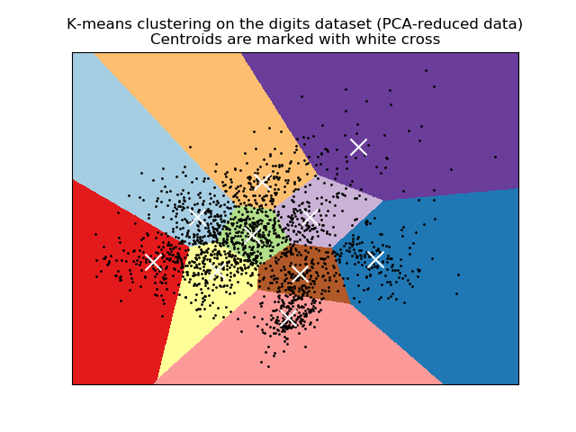
k-means Clustering
Here we chose 𝑘=10
We have two numeric features
The white crosses are cluster centroids
The colors show cluster assignments
image source: [scikit-learn.org]

Slide 7
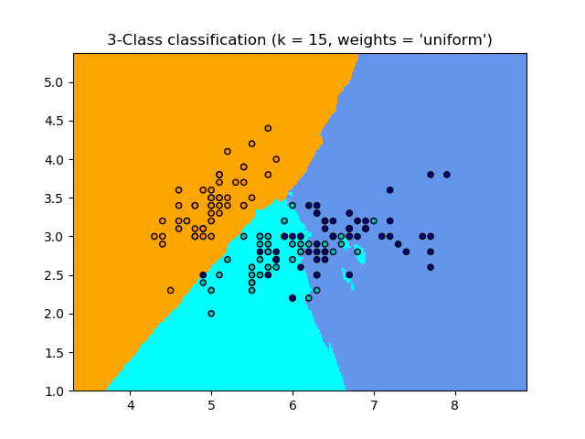
k-nearest neighbor
𝑘 is the number of neighbors to consider
Colors show the labels
The colors of regions show decision boundaries
Larger 𝑘 makes decision boundary smoother
image source: [scikit-learn.org]

Slide 8
Notebook Time

Slide 9
k-means algorithm implementation
Start with 𝑘 random centroids in the feature space, preferably spread out well
Calculate the Euclidean distance of every row to each of the 𝑘 centroids
Assign each row to whichever centroid it is closest to
Recalculate cluster centroids
Repeat steps 2 through 4 until results stabilize

Slide 10
k-means assumption
Euclidean distance means that
Categorical data must be represented numerically
Numeric data must be normalized
We want to maximize variability between clusters
i.e. cluster centroids should be far away from each other
We want to minimize variability within clusters
i.e. points belonging to the same cluster should be close to the centroid of their cluster

Slide 11
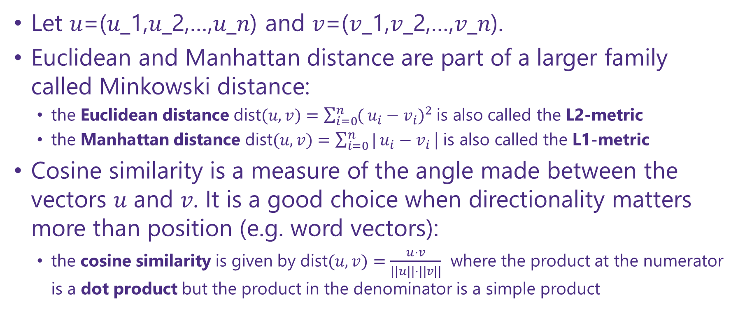
Numeric Distance Metrics
Let 𝑢=(𝑢_1,𝑢_2,…,𝑢_𝑛) and 𝑣=(𝑣_1,𝑣_2,…,𝑣_𝑛).
Euclidean and Manhattan distance are part of a larger family called Minkowski distance:
the Euclidean distance $\text{dist}(u,v)=\sum_{i=0}^{n}{(}u_{i}−v_{i})^{2}$is also called the L2-metric
the Manhattan distance $\text{dist}(u,v)=\sum_{i=0}^{n}{|}u_{i}−v_{i}$| is also called the L1-metric
Cosine similarity is a measure of the angle made between the vectors 𝑢 and 𝑣. It is a good choice when directionality matters more than position (e.g. word vectors):
the cosine similarity is given by $\text{dist}(u,v)=\frac{u⋅v}{||u||⋅||v||}$ where the product at the numerator is a dot product but the product in the denominator is a simple product

Slide 12
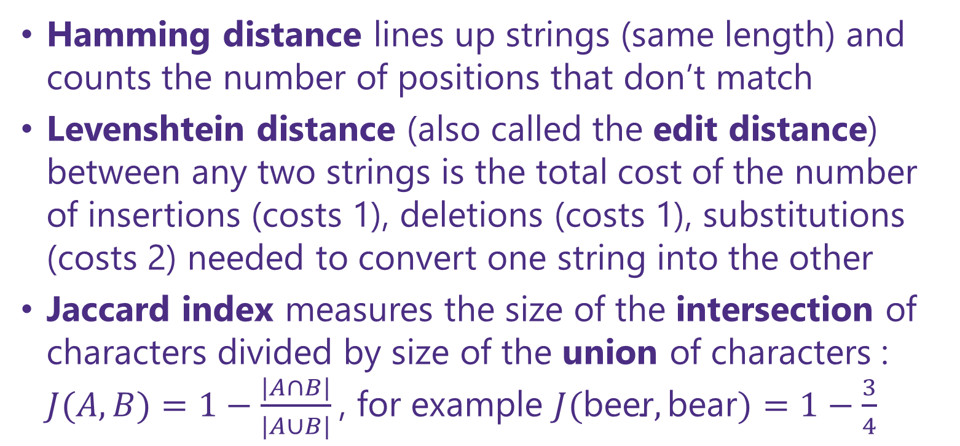
Categorical Distance Metrics
Hamming distance lines up strings (same length) and counts the number of positions that don’t match
Levenshtein distance (also called the edit distance) between any two strings is the total cost of the number of insertions (costs 1), deletions (costs 1), substitutions (costs 2) needed to convert one string into the other
Jaccard index measures the size of the intersection of characters divided by size of the union of characters : $J(A,B)=1−\frac{|A∩B|}{|A∪B|}$, for example $J(\text{beer},\text{bear})=1−\frac{3}{4}$

Slide 13
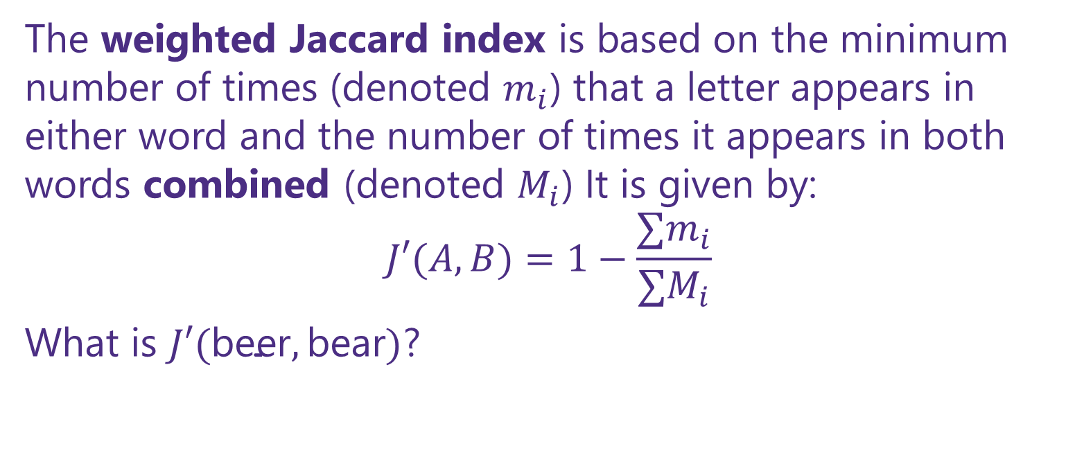
discussion
The weighted Jaccard index is based on the minimum number of times (denoted $m_{i}$) that a letter appears in either word and the number of times it appears in both words combined (denoted $M_{i}$) It is given by:
$$J′(A,B)=1−\frac{∑m_{i}}{∑M_{i}}$$
What is $J′(\text{beer},\text{bear})$?

Slide 14
Break Time

Slide 15
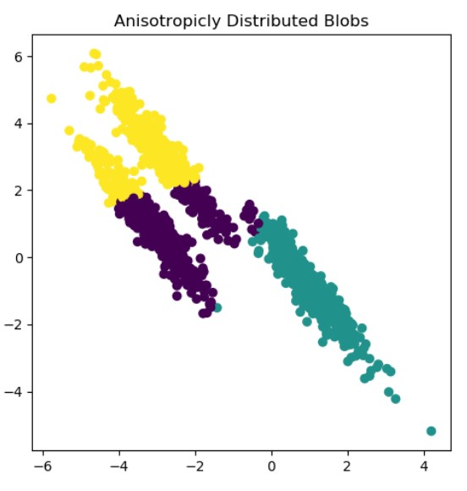
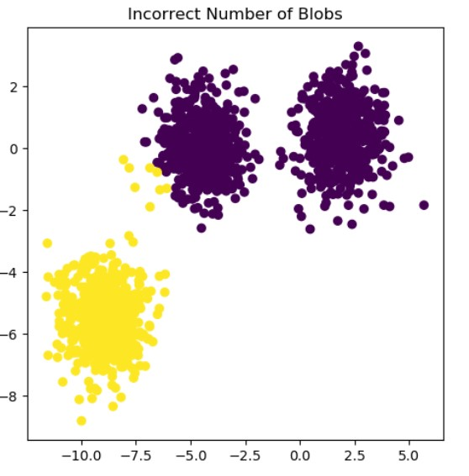
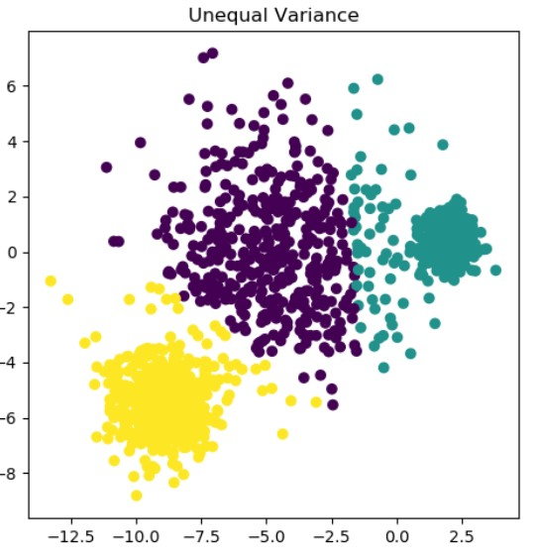
Discussion
You are presented with 3 different situations where k-means didn’t work as intended
Look at the scatter plot and do your best to explain why k-means didn’t work as intended in each situation
Propose an approach for what to do to avoid getting in such a trap
Even though the examples are 2 dimensional, your approach should work even when we have more than 2 features and cannot rely on data visualization
image source: [scikit-learn.org]

Slide 16
k-means Fail # 1
Data distributions follow slanted shapes
Avoid this by excluding highly correlated features
We can try certain transformations, e.g. rotation or PCA

Slide 17
k-means Fail # 2
We are too conservative in our choice of 𝑘
We can catch this by increasing 𝑘 and noticing a big drop in within-cluster variability

Slide 18
k-means Fail # 3
The middle cluster looks like it should own more of the points around it
This is a tough one
Re-running with different seeds can help identify borderline points

